Slide 1
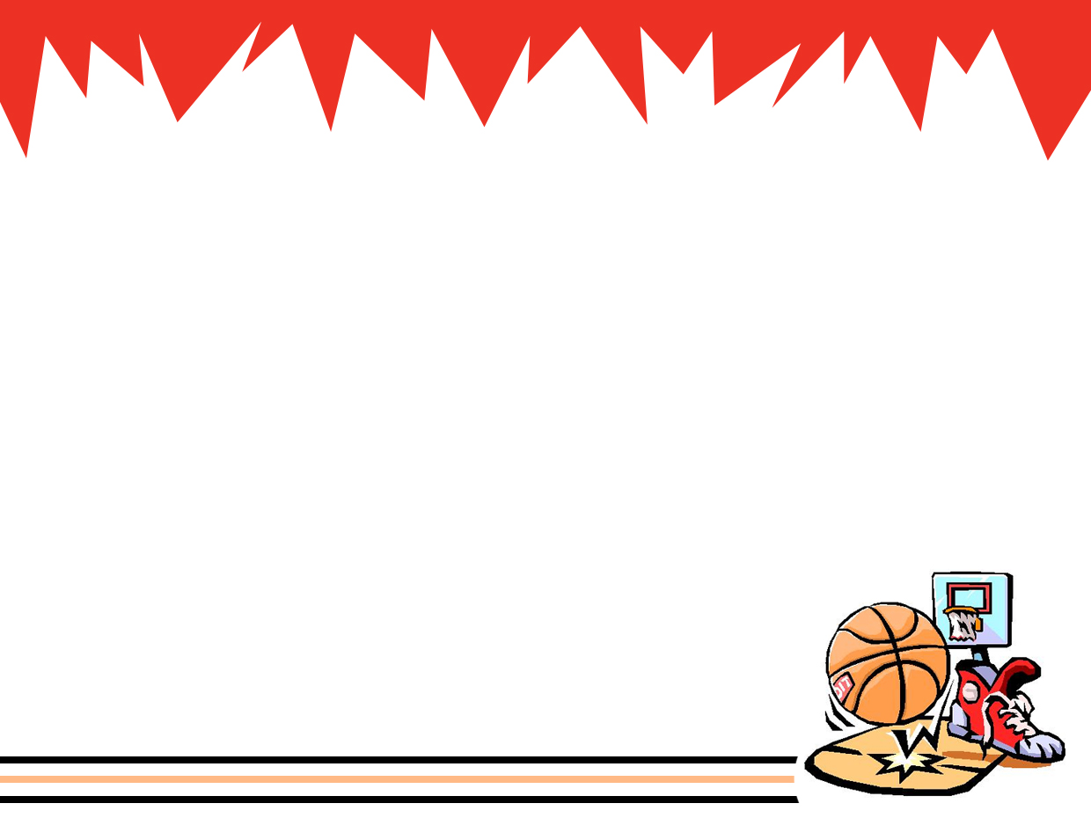
PHYSICS IN AMUSEMENT PARKS AND SPORTS (part 3)

Slide 2
RECALL
Mechanics
Kinematics
(Study of description of motion)
Dynamics
(Study of the cause of motion)

Slide 3
Review
Velocity – measures motion
Acceleration – measures change in motion

Slide 4
Constant Velocity
x vs t is linear
x = x_{o} + v t
x
v = slope
x_{o}
t

Slide 5
Constant Acceleration
x
x = x₀ + v₀t + ½ at²
t
Position changes with time in parabolic manner

Slide 6
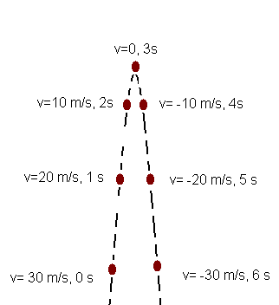
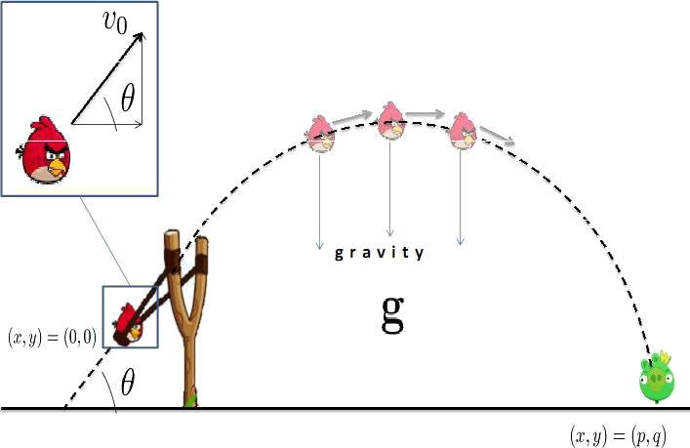
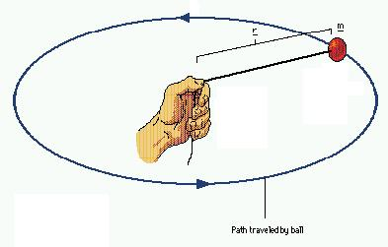
Constant Acceleration
Examples
Freefall
Projectile (2D Freefall)
Uniform Circular Motion

Slide 7
Force
Quantitative description of the interaction between bodies or between a body and its surrounding
Vector quantity
Unit: Newton = kg•m/s²

Slide 8
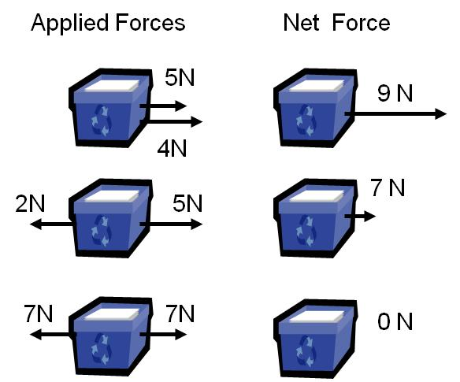
Net Force
Vector sum of all the forces
3 N

Slide 9
Newton’s Law of Motion
Summarize the principles of dynamics in terms of three laws
Characteristics
Fundamental
Foundation of classical (Newtonian) Mechanics
Can not be derived from other principles
Not Universal
Modify at very small sizes (sub-atomic particle)‏
Modify at high speeds (near the speed of light)

Slide 10
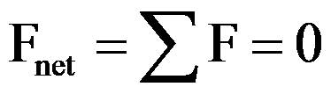
Newton’s 1st Law: Law of Inertia
When the net external force acting on an object is zero, the acceleration of the object is zero.

Slide 11
Newton’s 1st Law
When the net external force acting on an object is zero, the object will continue its “original” motion (zero acceleration).
At rest – continue to be at rest
Moving – continue moving at same velocity

Slide 12
Newton’s 1st Law
Describes motion in equilibrium
Equilibrium - does not change motion (constant velocity)

Slide 13
Newton’s 1st Law
F = 0
“Zero net external force” does not means “no force”

Slide 14
Question #1
A spacecraft engine dies when it is moving in the vacuum of outer space far from any planet (We assume that no force is acting on the system). Will the spacecraft stop? What does Newton’s first law say about this?

Slide 15
Answer
No, the spacecraft will not stop. According to Newton’s first law, if net force is zero, the object’s motion will not change and since the spacecraft is moving it will just continue moving.

Slide 16
Question # 2
The net external force of a moving car becomes zero. The frictional force is not negligible. What will happen to the car?
It will move slowly until it stop
It will continue to move

Slide 17
Answer
(b) It will continue to move
Since the net external force becomes zero, then the car will just continue its motion
“Zero net external force” does not means “no force”

Slide 18
Question # 3
A ball was thrown upward with an initial velocity. While moving upward, the net external force acting on the ball became zero. What will happen to the ball?
It will fall
It will stop
It will move upward

Slide 19
Answer
c) It will move upward
Since the net force becomes zero, then the ball will just continue moving upward
“Zero net external force” does not means “no force”

Slide 20
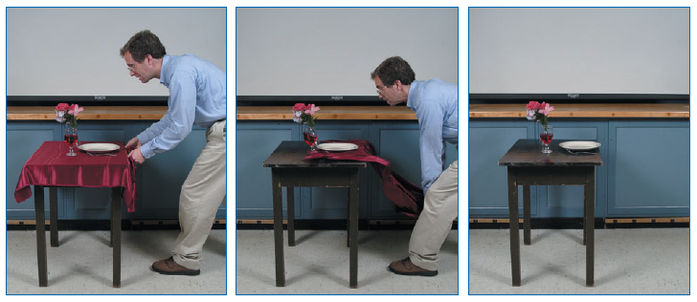
INERTIA
One famous “magical” effect is the feat of removing a tablecloth from a set table without breaking the dishes on top.

Slide 21
NEWTON’S 2nd LAW
The Law of Acceleration
F_{net} = m a
“The magnitude of the net external force (F_{net}) is the product of the mass of the object and the magnitude of its acceleration (a) ”

Slide 22
NEWTON’S 2nd LAW
Describes motion of a body that is not in equilibrium.
If a net external force acts on a body, the body accelerates (change motion).
“F_{net} = ma” not “F = ma”

Slide 23
NEWTON’S 2nd LAW
The direction of acceleration is the same as the direction of the NET force.
a
Net Force

Slide 24
Inertia and Mass
“F_{net} = ma”
Inertia is the tendency of an object to resist change in motion
Mass is a measure of the inertia

Slide 25
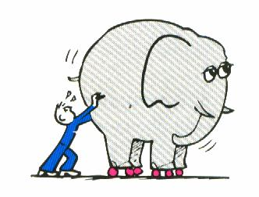
Inertia and Mass
The greater the mass, the smaller the acceleration (change in motion) for a given amount of force

Slide 26
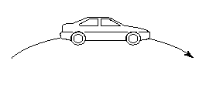
Concept Test
A car rounds a curve while maintaining a constant speed. Is there a net force on the car as it rounds the curve?

Slide 27
Answer
Yes
Acceleration is a change in the speed and/or direction. Thus, because its direction has changed, the car has accelerated and a net force must have been exerted on it.

Slide 28
Review
Dynamics – “understand” motion
Force – measure of interaction
Newton’s 1st Law - motional equilibrium
F_{net} = 0 → constant velocity

Slide 29
Review
Newton’s 2nd Law - not in motional equilibrium
F_{net} = ma → acceleration
m = mass → inertia (tendency to resist change in motion)

Slide 30
Newton’s Third Law: The Law of Interaction
If object A exerts a force F on object B then object B exerts a force on A that is equal in magnitude and opposite in direction.
F_{BA} = - F_{AB}
These two forces act on different bodies.
A
B

Slide 31
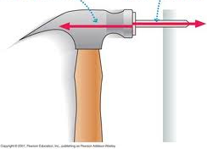
Newton’s Third Law: The Law of Interaction

Slide 32
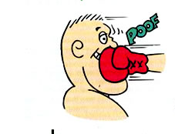
Newton’s Third Law: The Law of Interaction

Slide 33
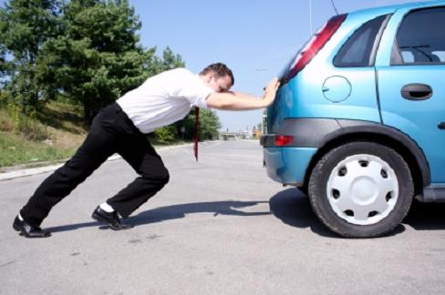
Newton’s Third Law: The Law of Interaction
www.blogging4jobs.com

Slide 34
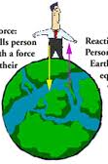
Newton’s Third Law: The Law of Interaction

Slide 35
Colliding Bodies
A fast moving heavy ball collides with a stationary light ball. Which of the two balls experience larger force?
Heavy Ball
Light Ball

Slide 36
Answer
They experience the same amount of force
Heavy Ball
Light Ball

Slide 37
Something to think about
A girl stated “if I exert a force on a cart by push it, then by Newton’s third law, the cart will also push me with a force equal in magnitude but in the opposite direction.

Slide 38
Something to think about
Thus, since there are two forces with equal in magnitude and opposite in direction, these forces will just cancel and the net force will be zero.

Slide 39
Something to think about
If the net force acting on the box is zero, then the box will not move, and pushing the box will be useless.”
What do you think?

Slide 40
Is this logical ?
F_{net} = 0
Reaction Force, F_{B}
Action Force, F_{B}
F_{A} – F_{B} = 0

Slide 41
ANSWER
Girl
Cart
Action and Reaction forces can NEVER CANCEL each other because they act on different bodies!

Slide 42
Types of Forces
1. Weight/Gravitational Force
2. Applied Force
3. Tensile (Tension)
4. Normal Force
5. Frictional
6. Spring Forces
A. Compressive Spring Force
B. Extensive Spring Force

Slide 43
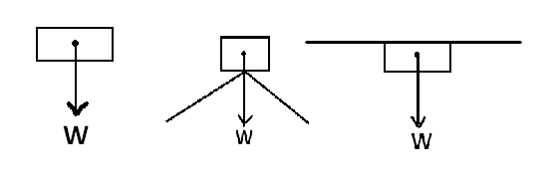
1. Weight, W
This is the force due to gravity
Always directed downwards (or towards the center of the earth/heavenly body)
W = mg

Slide 44
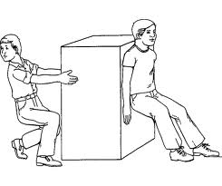
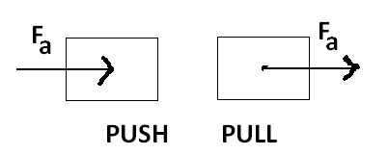
2. Applied Force, F_{a}
Forces that are applied to systems by force loads, and can't be classified as other types of forces
push or pull
www.siliconbeachtraining.co.uk

Slide 45
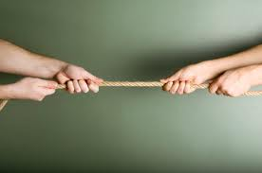
3. Tension, T
kevincraig.us
It is a force that arises from pulling using strings.
It is always directed away from the object being pulled.
45°
55°
T₁
T₂
Rope 1
Rope 2

Slide 46
4. Normal Force, N
This force is always directed perpendicular to the surface of contact.
The normal force acts as a balancer or support.
N
N

Slide 47
5. Frictional Force
Always directed parallel to the surface of contact.
Always directed against the direction of motion
Two types: Static (F_{s}) and Kinetic (F_{k})

Slide 48
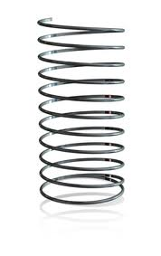
6. Spring Force
Force related to the ability of a spring (or any elastic material) to return to its original state
racksandmooby.blogspot.com

Slide 49

Centripetal Force, F_{c}
Net inward force which provides centripetal acceleration (a_{c})
Direction = towards the center
F
F
F
F

Slide 50
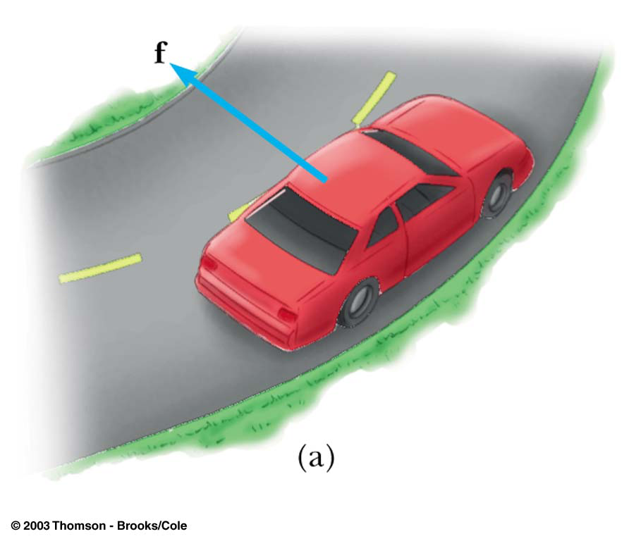
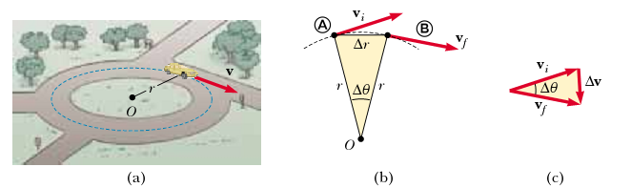
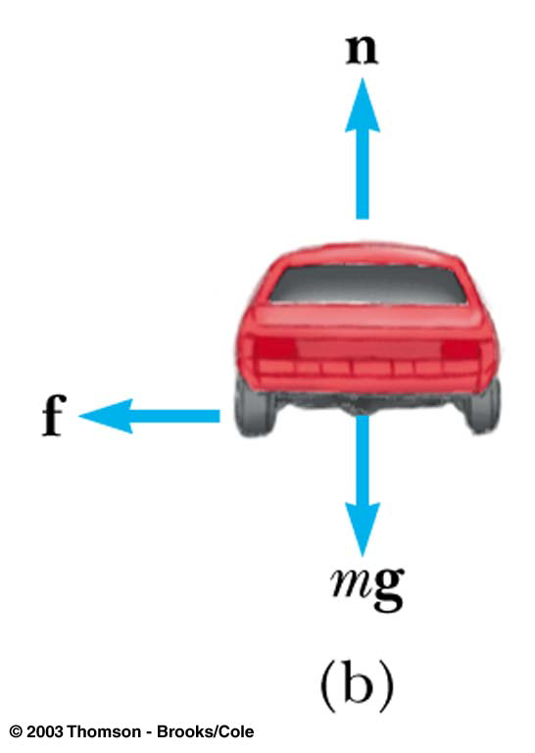
Unbanked Curve
Friction

Slide 51
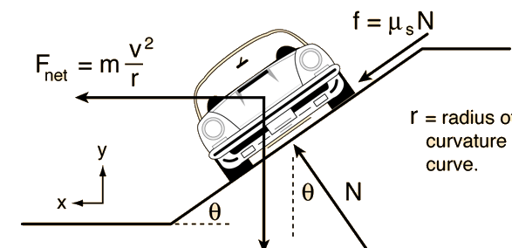
Banked Curve
Normal Force

Slide 52
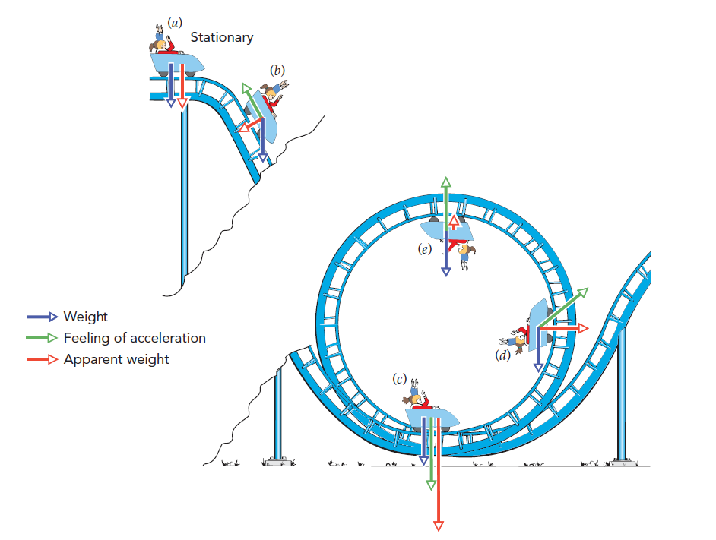
Amusement Park Rides: Feeling the acceleration

Slide 53
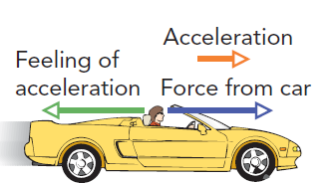
Feeling the acceleration
As you accelerate forward in a car, you can feel its acceleration in the opposite direction
This feeling of acceleration is really the mass of your body resisting acceleration.
Bloomfield, L. (2010). How things work – The Physics of everyday life 4th edition. John Wiley and Sons

Slide 54
Sudden Stop
Feeling of acceleration
acceleration
Decreasing velocity

Slide 55
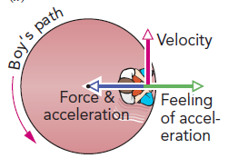

Carousel
The “outward force” that you feel, is due to the centripetal acceleration
The “outward force” that you feel, is due to the centripetal acceleration

Slide 56
Feeling of acceleration
Bloomfield, L. (2010). How things work – The Physics of everyday life 4th edition. John Wiley and Sons

Slide 57
Feeling of acceleration

Slide 58
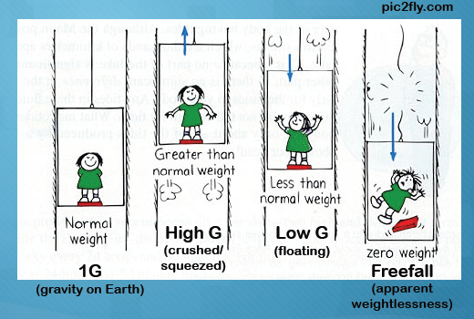
Apparent Weight
Weight registered in a weighing scale, which is equivalent to the normal force
The weight that you “feel”
a
Normal Force (Apparent Weight)
Weight
Bloomfield, L. (2010). How things work – The Physics of everyday life 4th edition. John Wiley and Sons

Slide 59
Apparent Weight
a =0
a
a
+N
+N
-N
-W
-W
+W
N – W = ma
W – N = ma
N – W = 0
N = W
N = W + ma
N = W - ma
Same Weight
Heavier Weight
Lighter Weight
Bloomfield, L. (2010). How things work – The Physics of everyday life 4th edition. John Wiley and Sons

Slide 60
Apparent Weight
Freefall
Bloomfield, L. (2010). How things work – The Physics of everyday life 4th edition. John Wiley and Sons

Slide 61
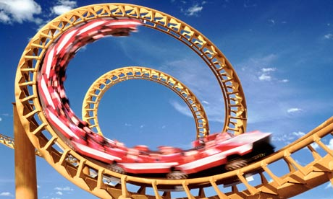
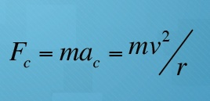
BIG vs SMALL
Where would you experience a greater acceleration – a small loop or a larger loop?
www.guardian.co.uk

